Slide 1

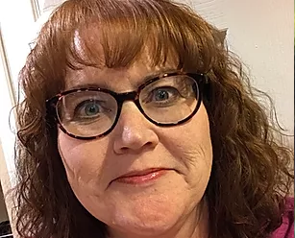

The Cactus
Connection
The Arizona Parrot Head Club Newsletter
Q2 2023
Can you believe we’re heading into the back end of 2023? It seems like only yesterday when you needed to wear a sweater and now it’s, well, hot. Let’s just go with hot without any adjectives because they would all be curses.
The club has been busy. In the first six months, we raised $1,326 dollars and committed 147 hours to charity. Thank you to all that contributed!
Our Prez: Kathy Pfister!!!
Parrot Grande registration opened at parrotgrande.com. The first 100 full weekend registrants will get a very cool memento. You don’t want to miss out so register soon as we’re getting closer to that number! We have people coming from six different states which will make it a great opportunity to make some new friends. Spread the word amongst your tribe - day passes are available for those who don’t want to/can’t commit to a full weekend.
Speaking of new friends, we’ve gotten some new members in the past few months who have joined us at some of our Happy Hours. So nice to get to know them! If you have friends that enjoy the same mix of charity and social
activities that we do, invite them to come to an event and check us
out. I think they’ll like us. ;)
Stay cool and hope to see you all at an event soon!
Kathy
CONTACT US: AZPHC PO Box 16093 Phoenix, AZ 85011-6093 Email: phred@parrotheads.org P. 1

Slide 2
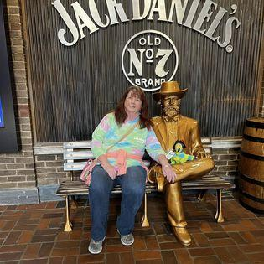
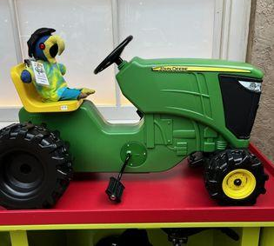
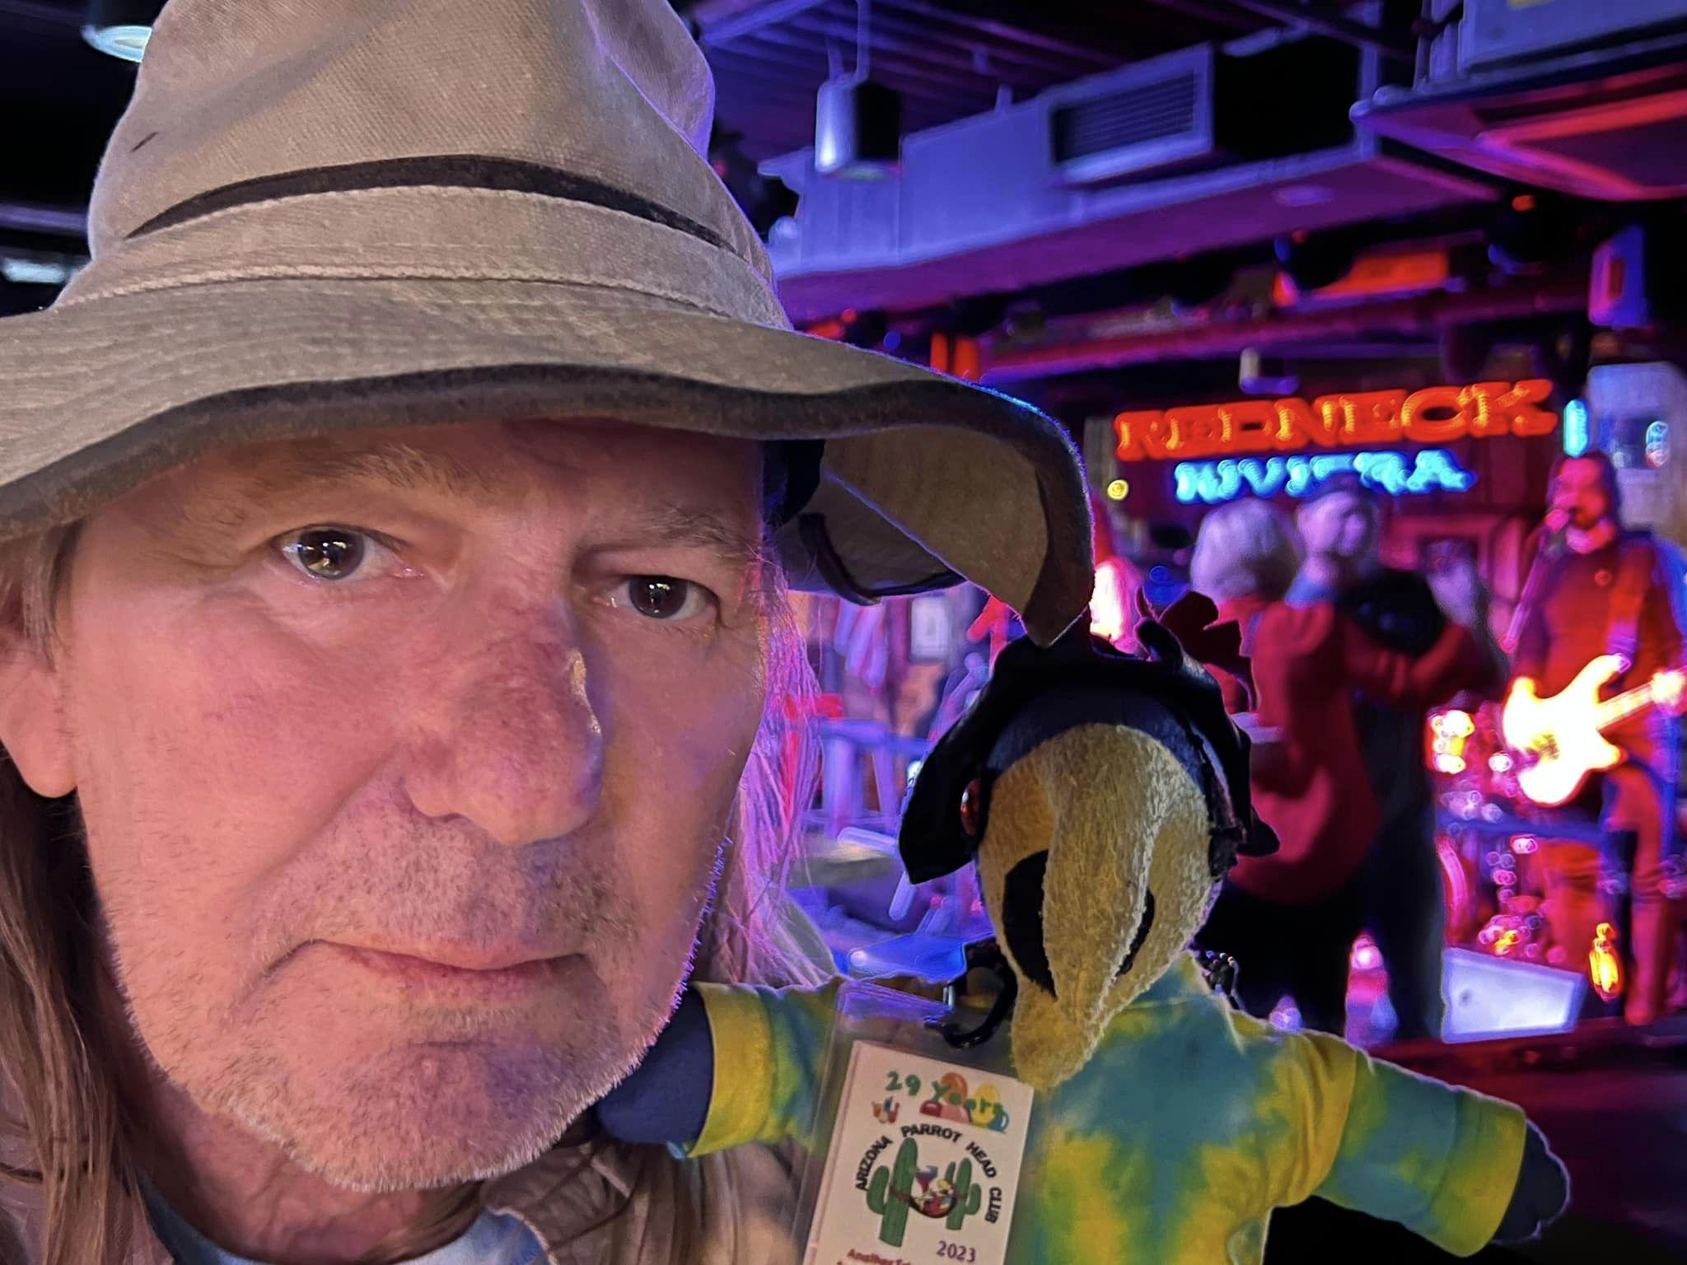
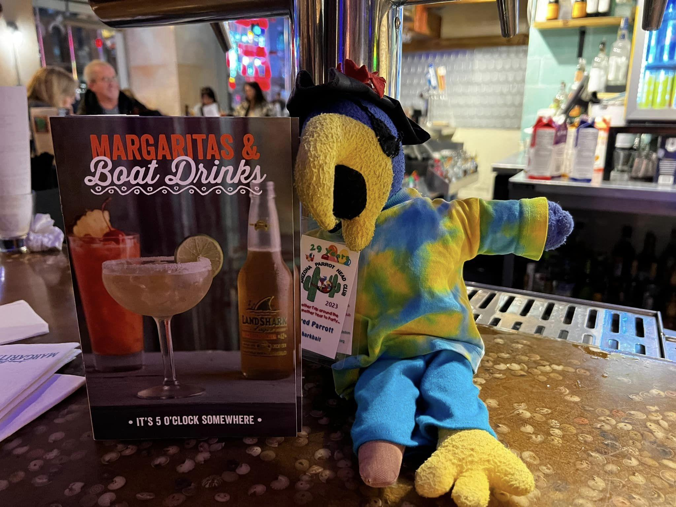
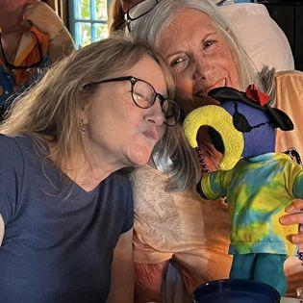
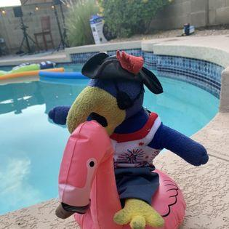
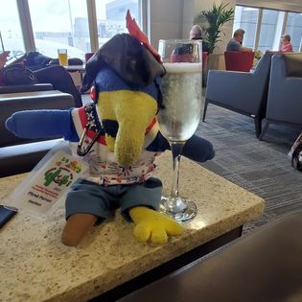
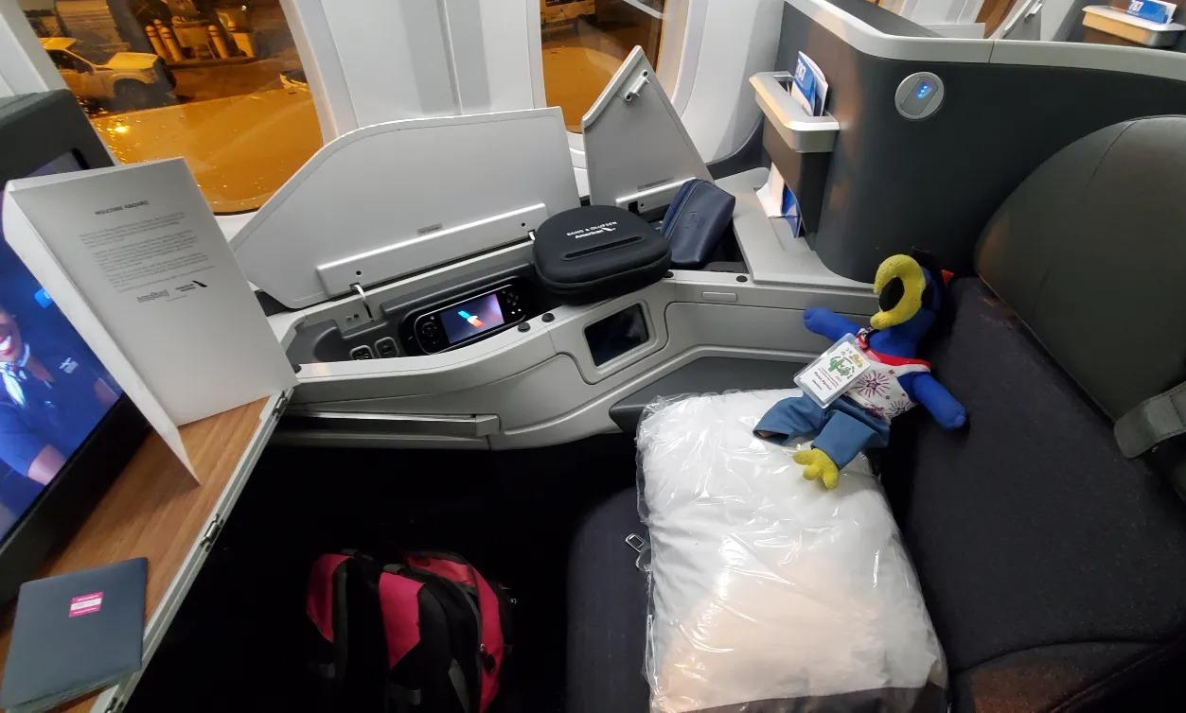
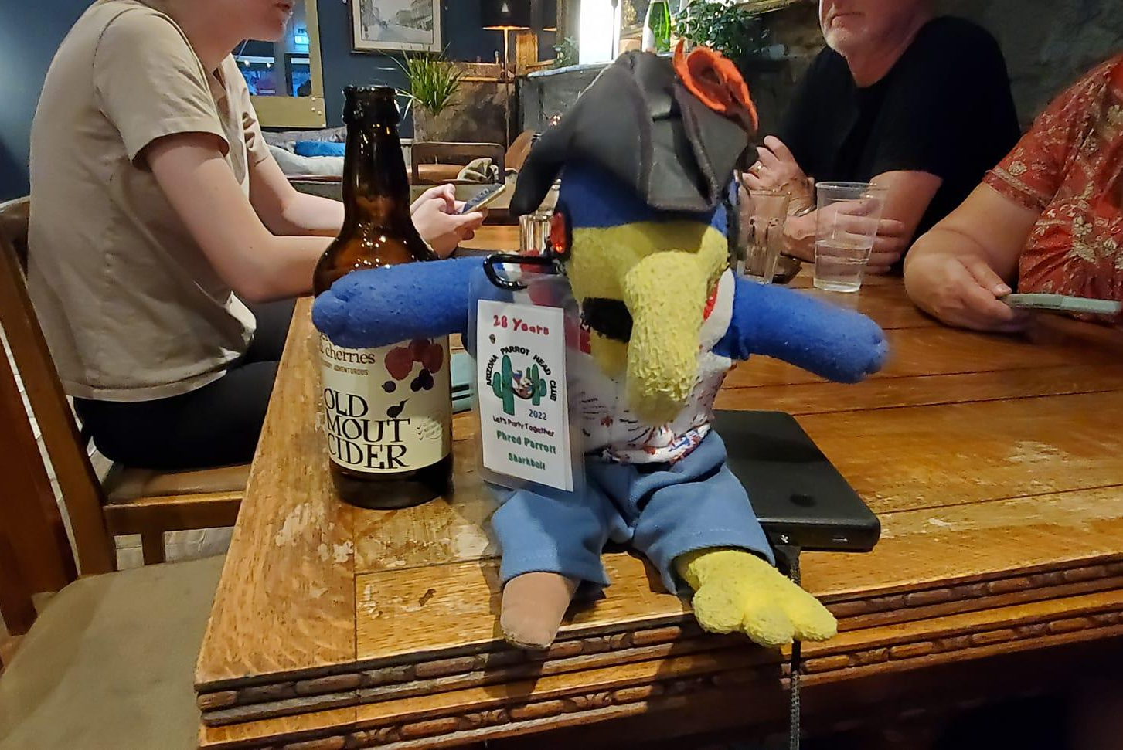
The Arizona Parrot Head Club Newsletter-Q3 2020
The Arizona Parrot Head Club Newsletter-Q2 2023
Phred’s Adventures 2nd Quarter 2023...by Queen
Another great quarter for Phred! I got to check out Tennessee; we went to Nashville, Gatlinburg and Knoxville. Got to taste some whiskey and moonshine! Great time celebrating the Queen's birthday. Also helped to host the Brent Burns House Concert - great to have Brent again! And rode a flamingo at the Aaron Scherz House Concert!
The Happy Hours are always fun and a great way to catch up with everyone. As I write this I am heading home from exploring England with my pal Paula who spoiled me and took me to the Cubs game there!
Until next quarter!
Phred
I’ve sure been having phun with Queen and Paula; but, I’d love to travel with other people, too! Just let Tammy know if you’d like to take me on an adventure with you…Later, Phred
CONTACT US: AZPHC PO Box 16093 Phoenix, AZ 85011-6093 Email: phred@parrotheads.org P. 2

Slide 3
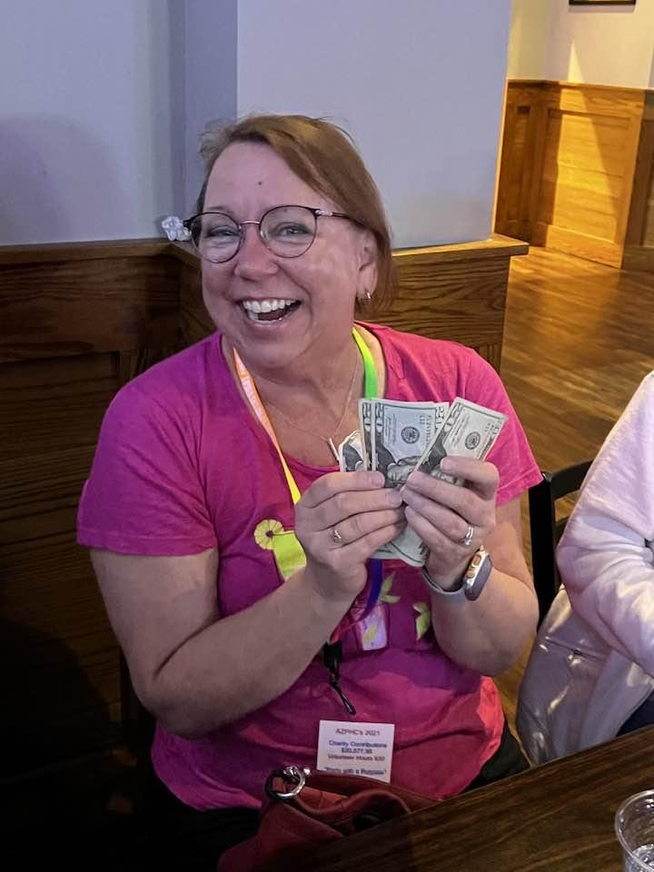
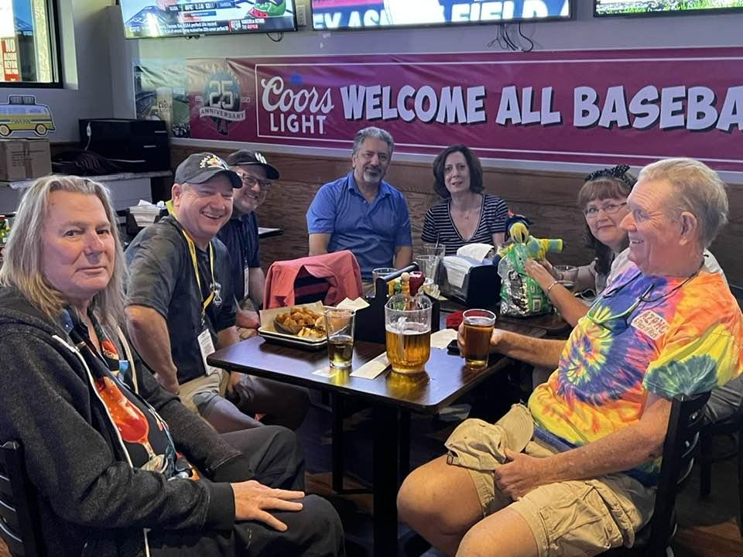
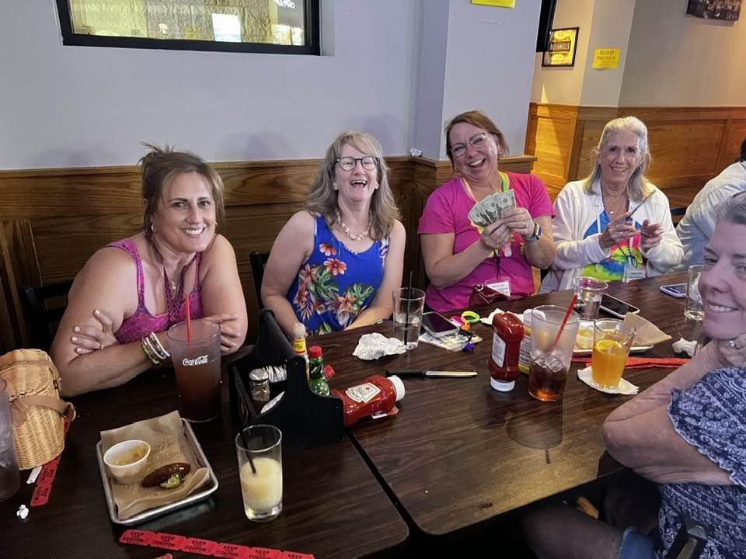
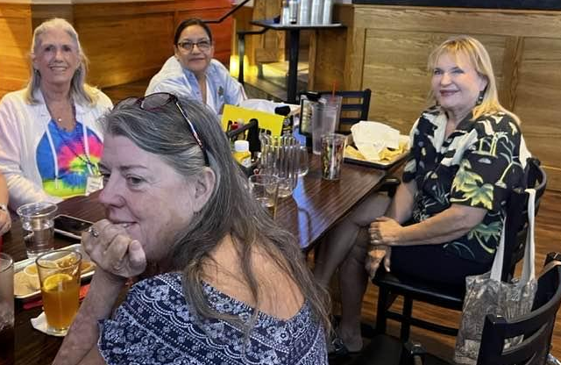
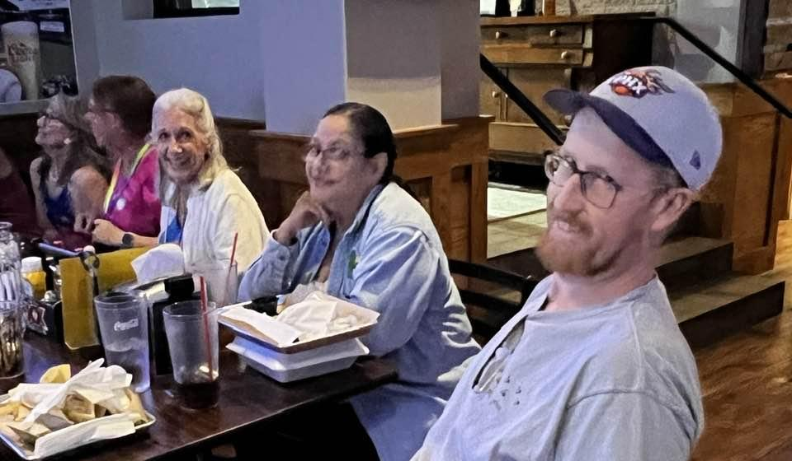
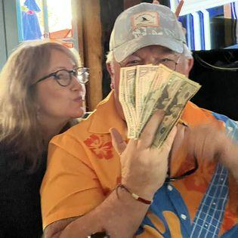
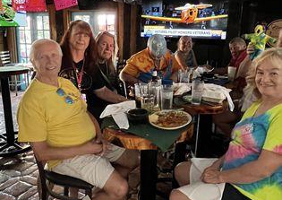
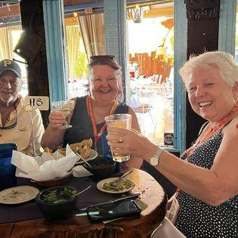
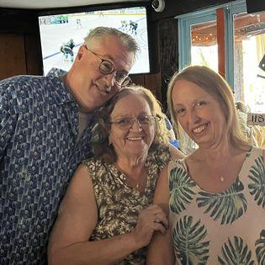
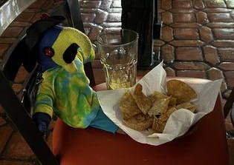
The Arizona Parrot Head Club Newsletter-Q2 2023
Q2 Happy Hours!!!
Doc and Eddy’s, Aunt Chilada’s and The Cabin
Doc and Eddy’s was our April HH with Sonja taking home the 50/50 and our proceeds going to our Q2 Charity, Soldiers’ Best Friend!!!
Our May HH was at Aunt Chilada’s with a great turnout and Mike winning the 50/50 for our Q2 charity!!!
CONTACT US: AZPHC PO Box 16093 Phoenix, AZ 85011-6093 Email: phred@parrotheads.org P. 3

Slide 4
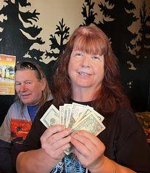
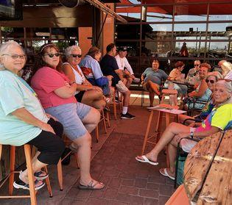
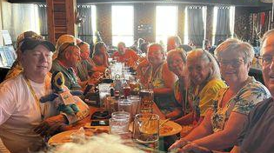
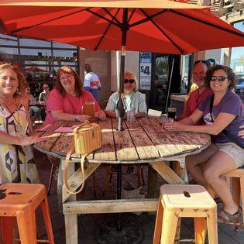
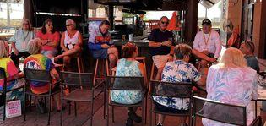
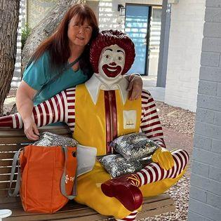
The Arizona Parrot Head Club Newsletter-Q2 2023
Q2 Happy Hours…cont.!!!
Doc and Eddy’s, Aunt Chilada’s and The Cabin
June HH was on the west side again at the Cabin, where we moved inside as it was already getting a little warm! Tammy took home the 50/50 this month!
A Thank you for poptops from the Ronald MacDonald House…
Hello Tammy Bauman,
On behalf of all of the families who call Ronald McDonald House Charities® of Central and Northern Arizona their "home-away-from-home", thank you for your generous gift of Pop tops received on 06/05/2023.
Thanks to your kindness, Ronald McDonald House® is here for families like the Bahr family from Eager, Arizona in their time of need.
Thank you so much for helping provide a "home-away-from-home" for the Bahrs and hundreds of other families so that they could face their toughest battles together. You make a difference!
CONTACT US: AZPHC PO Box 16093 Phoenix, AZ 85011-6093 Email: phred@parrotheads.org P. 4

Slide 5
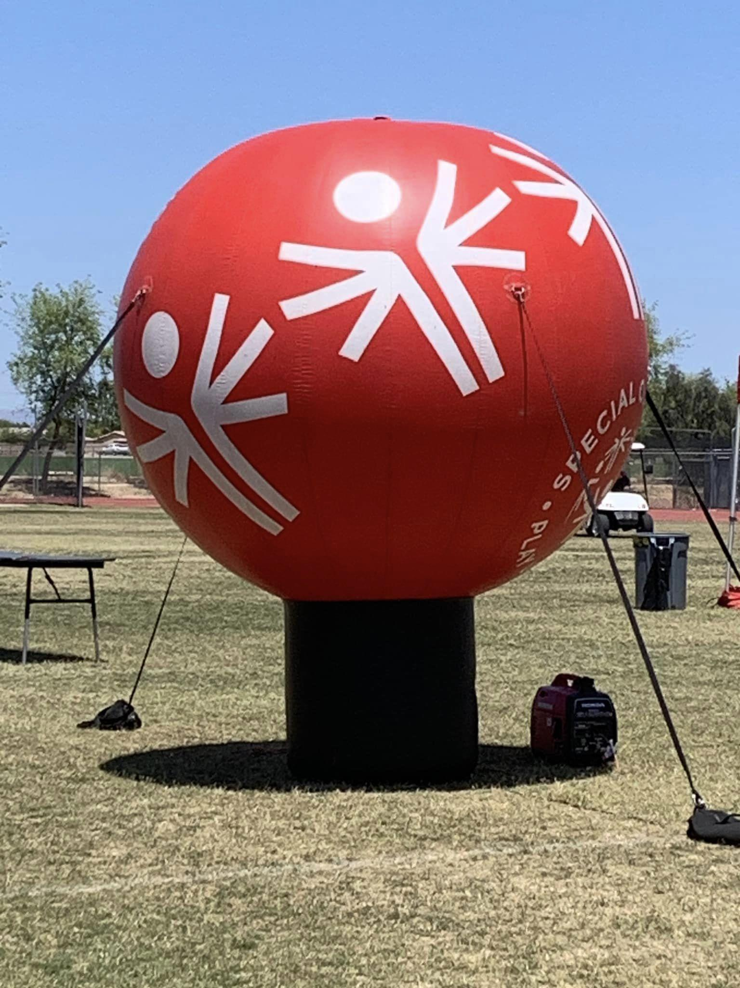
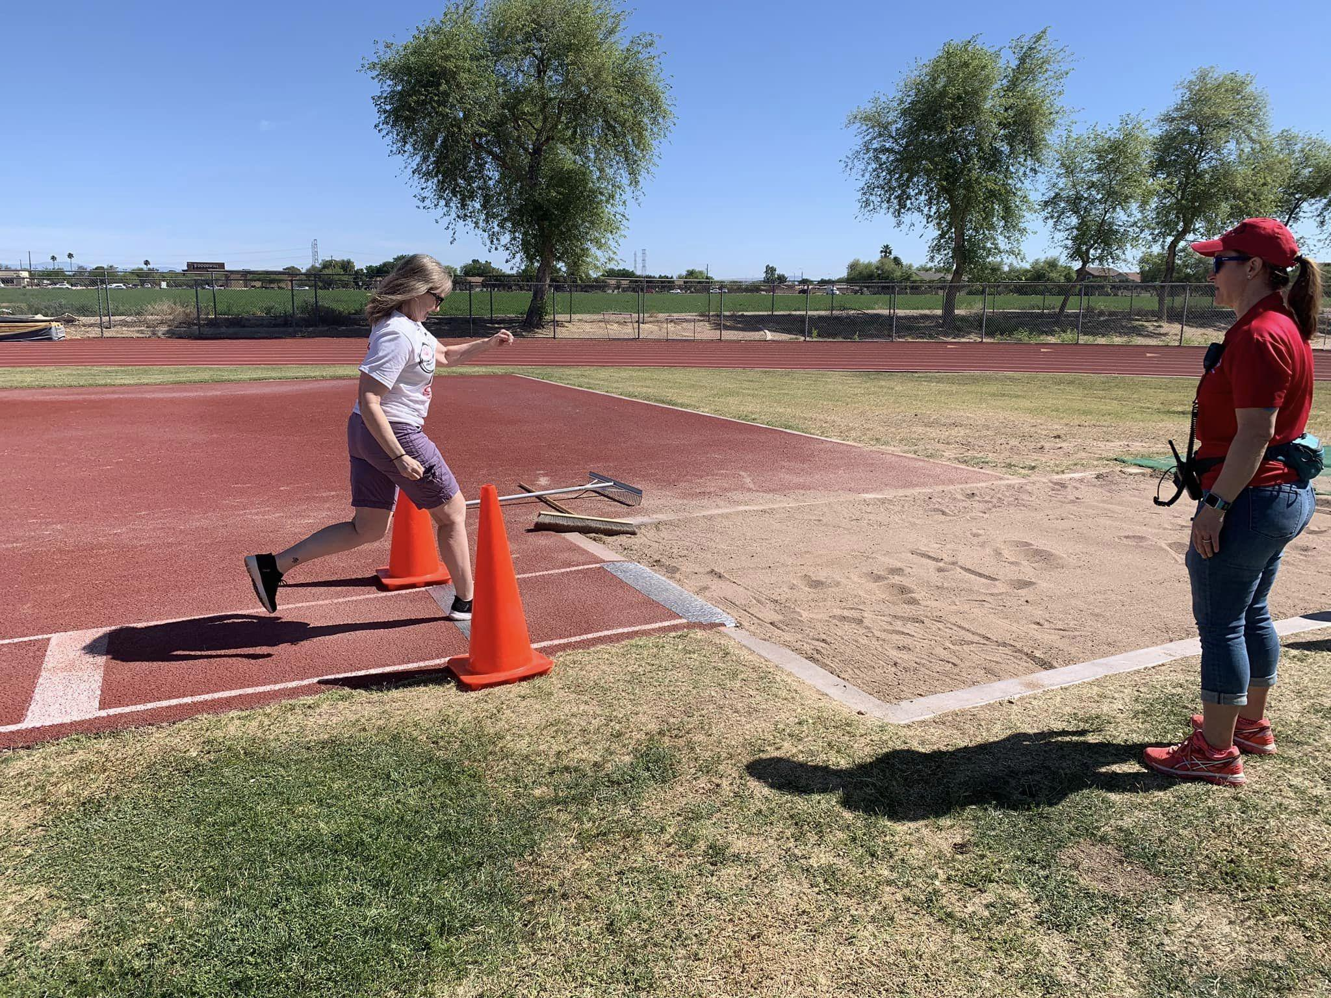
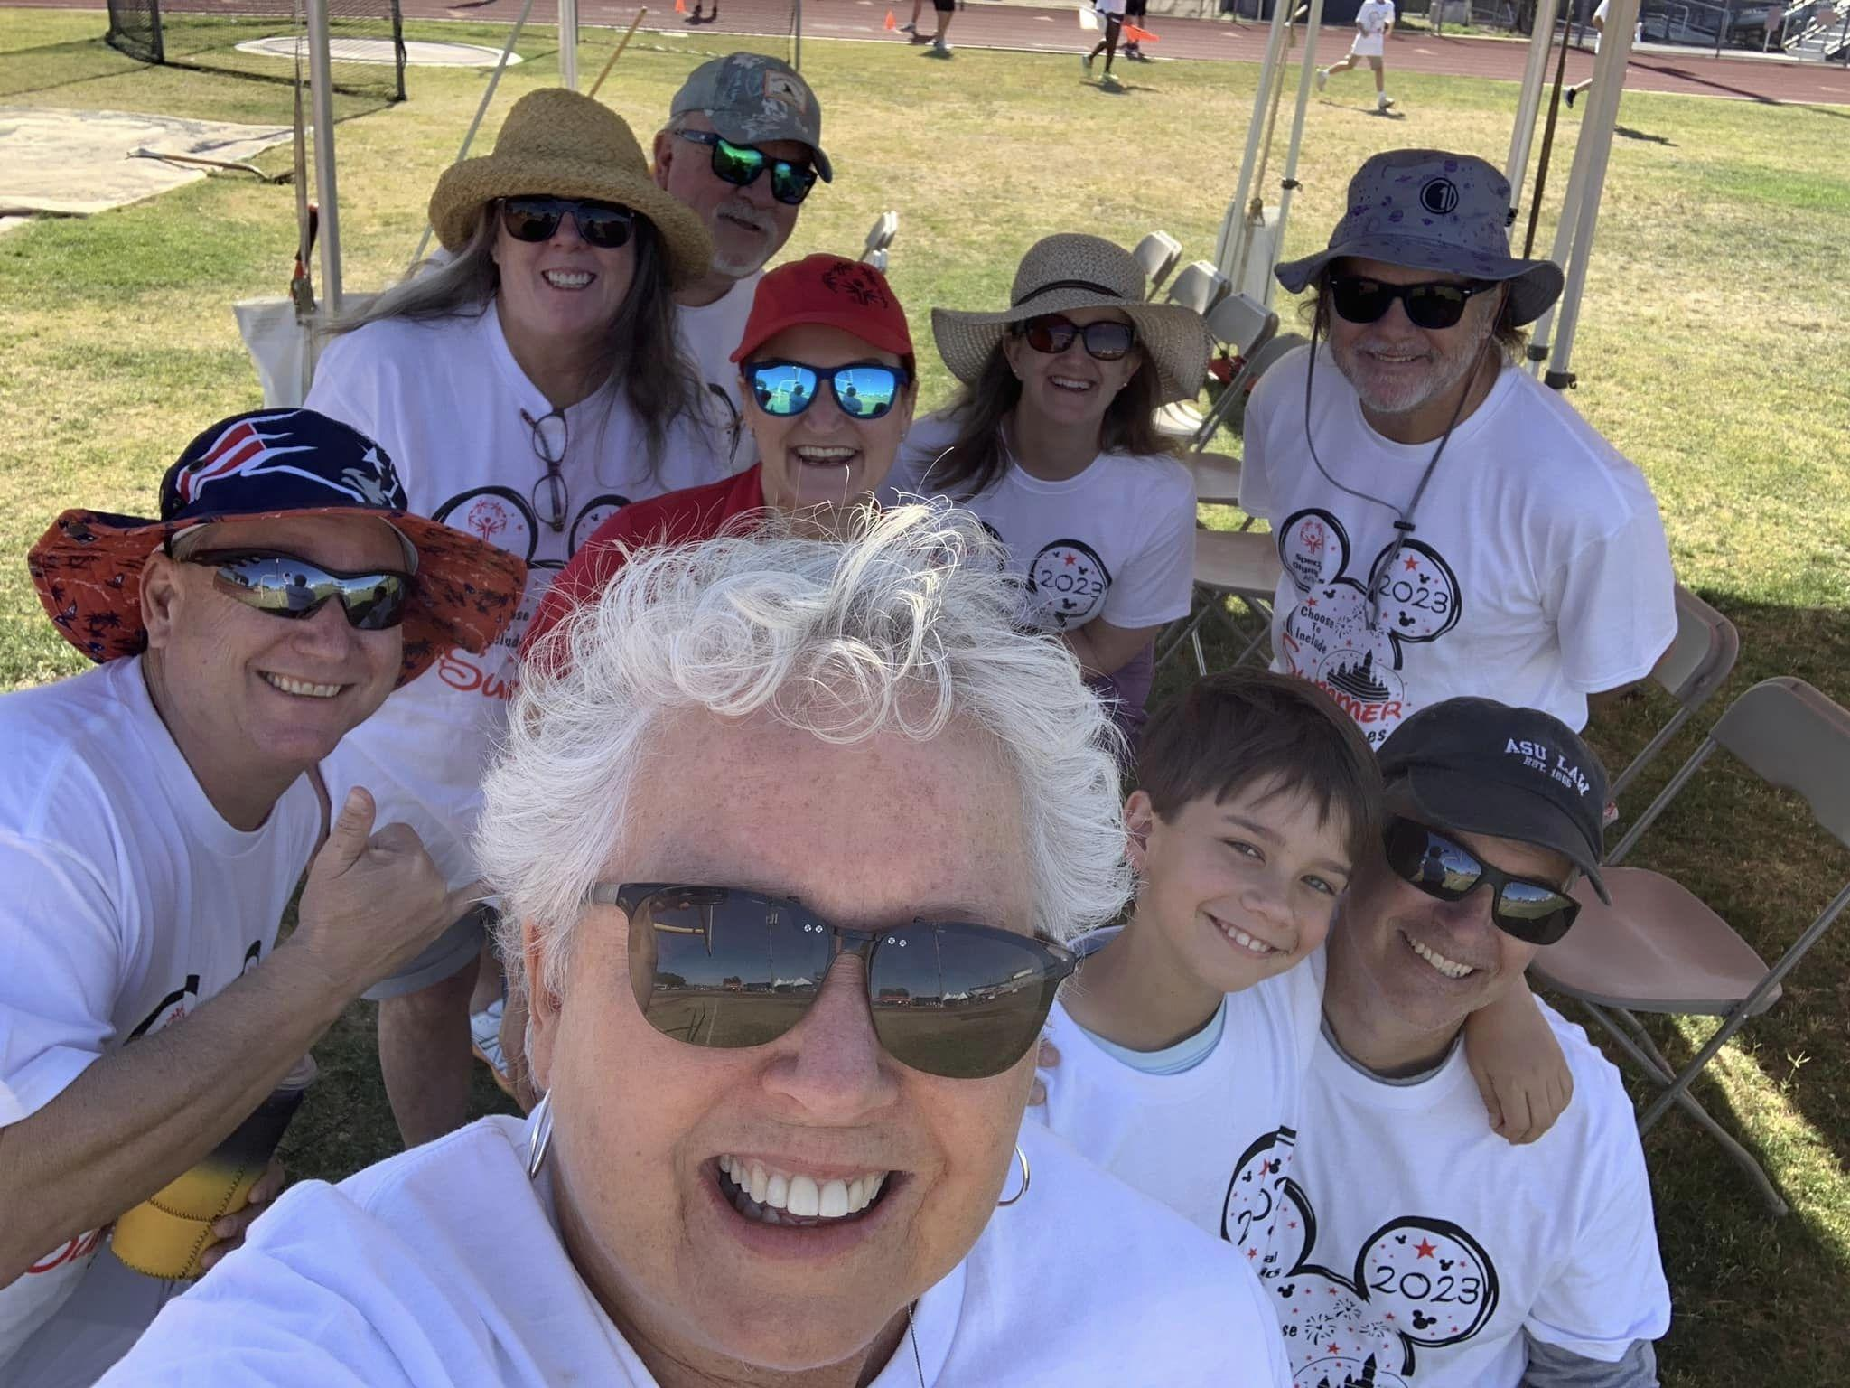
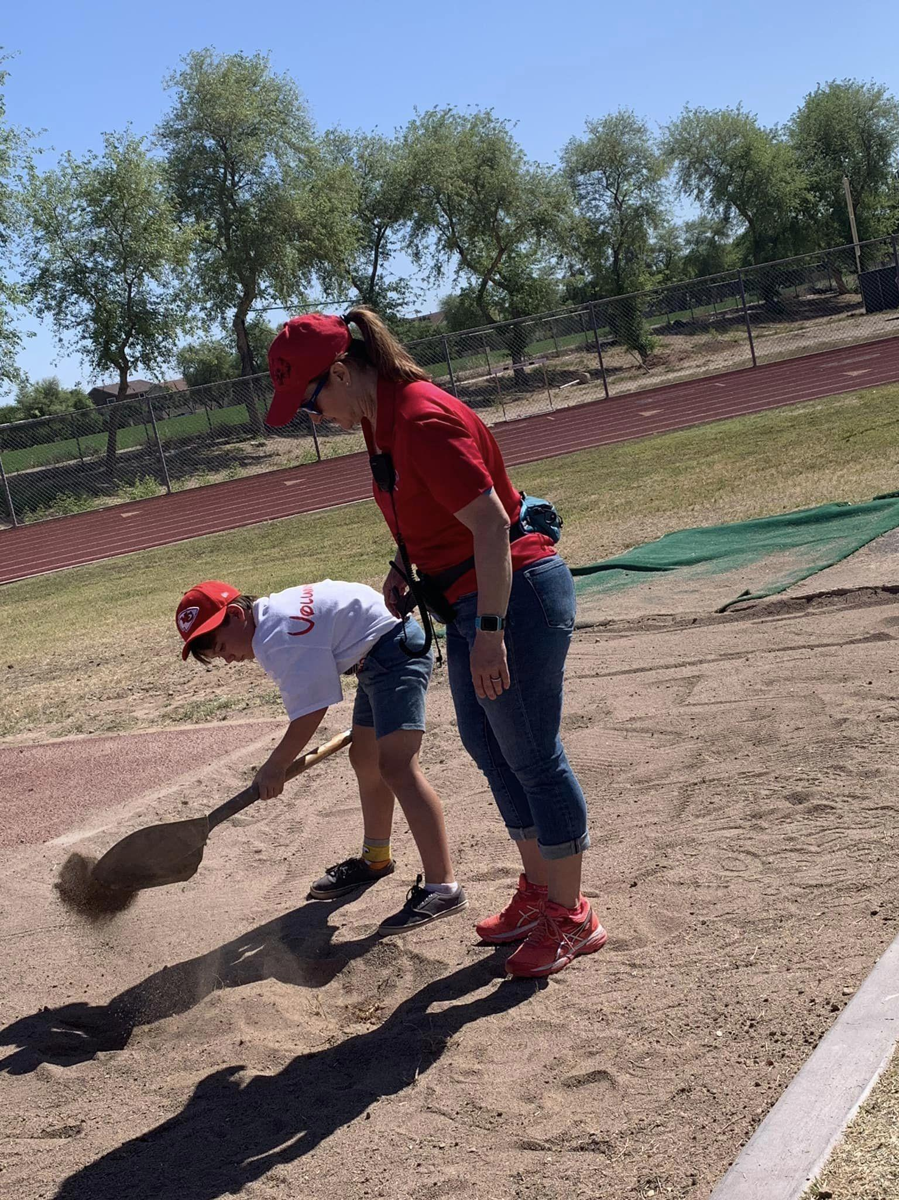
The Arizona Parrot Head Club Newsletter-Q2 2023
Special Olympic Summer Games…by Mike McMahon
On Saturday, May 6th the Arizona Parrot Head Club volunteered to support the Running Long Jump event for the Arizona State Summer Special Olympic Games. The athletes are amazing!! 7 members helped for 6 hours each, for a total of 42 volunteer hours. Thank you to Mette Rasmussen, Tracy Kenison, Scott Holt, Patty Henry King, Frank Pastula and Bob (the new guy) for volunteering and making it fun! Mucho appreciated!
Patty tried the jump!
The Team!
We also received this email from them:
Thank you so much for sharing your time with us at Summer Games 2023! With your help, SOAZ was able to provide high level competitions in 6 different events, as well as providing a fun and engaging experience for the approximately 900 athletes and partners, as well as the coaches, family members, and all others who were involved!
Between the three days of competition we had 831 day-of volunteers that served over 2,000 hours! Thank you for being a part of this amazing community working toward inclusion for all, we hope you had a great time!
Our little helper and the boss!
CONTACT US: AZPHC PO Box 16093 Phoenix, AZ 85011-6093 Email: phred@parrotheads.org P. 5

Slide 6
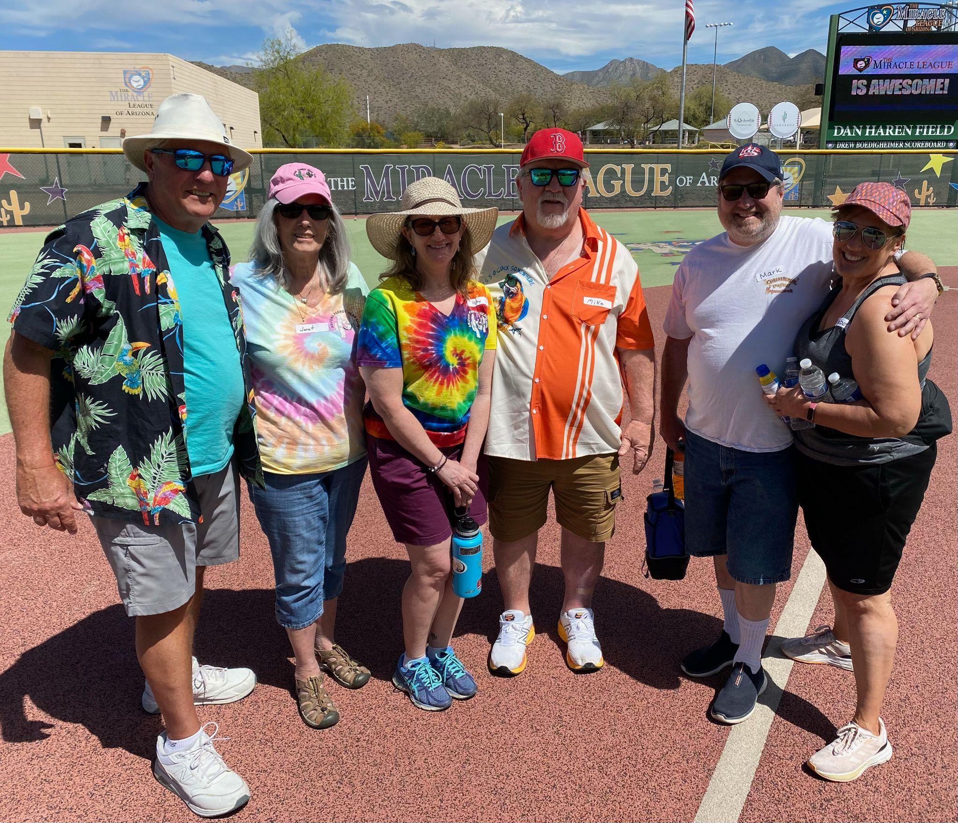
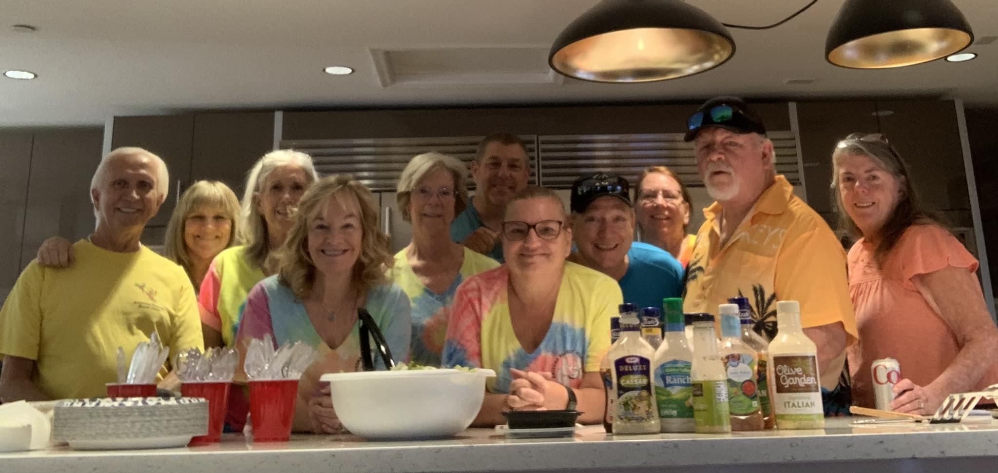
The Arizona Parrot Head Club Newsletter-Q2 2023
More Q2 Charitable Events…Partying with a Purpose!!!
Miracle League of Arizona…by Mike McMahon
On April 1, 2023 6 Arizona parrot heads volunteered at the Baseball facility: Miracle League of Arizona in Scottsdale for 20 total volunteer hours. A huge thank you to those that did a fantastic job, cheering, assisting varied players with disabilities, playing catch, running/walking the bases. Those individuals were Janet Spittle, Frank Pastula, Patty King, Deborah and Mark Sarna and Mike McMahon! A consenus of these volunteers shared that they thoroughly enjoyed the experience and that we could do this 2x a year. We can target the Fall season to assist again! (less hot outtside)
Ronald McDonald House Dinner (note from them…)
Dear Michael, Scotty, Tracy, Paula, Sonja, Lori, Larry, Denise, Janet, Toni, & Rocky,
Thank you so much for the amazing dinner you provided for our families staying at our Roanoke House Saturday night! Michael, our Guest Services Coordinator, said you were an awesome group and had nothing but good things to say about you.
😊 We are truly grateful for your support and generosity.
We have been struggling to get volunteers back into our Houses to prepare nightly meals for our families. Providing a healthy meal to our families is a priority for us. After spending long days at the hospital, families come home to rest and eat so they have the strength and energy they need to care for their sick or injured children.
We are so grateful to our Dinnertime Hero’s volunteers. Your time, talent, and healthy meals are received with tremendous love and gratitude. We could not do what we do here at the Ronald McDonald House without our amazing volunteers and hope that you will consider come back again to prepare dinner.
CONTACT US: AZPHC PO Box 16093 Phoenix, AZ 85011-6093 Email: phred@parrotheads.org P..6

Slide 7
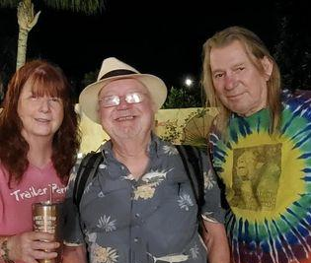
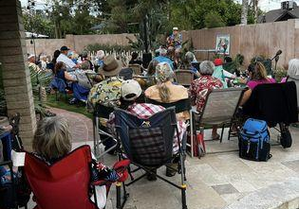
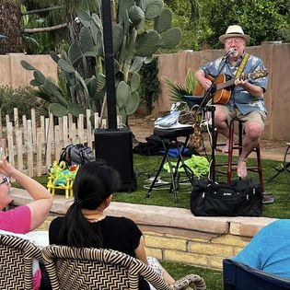
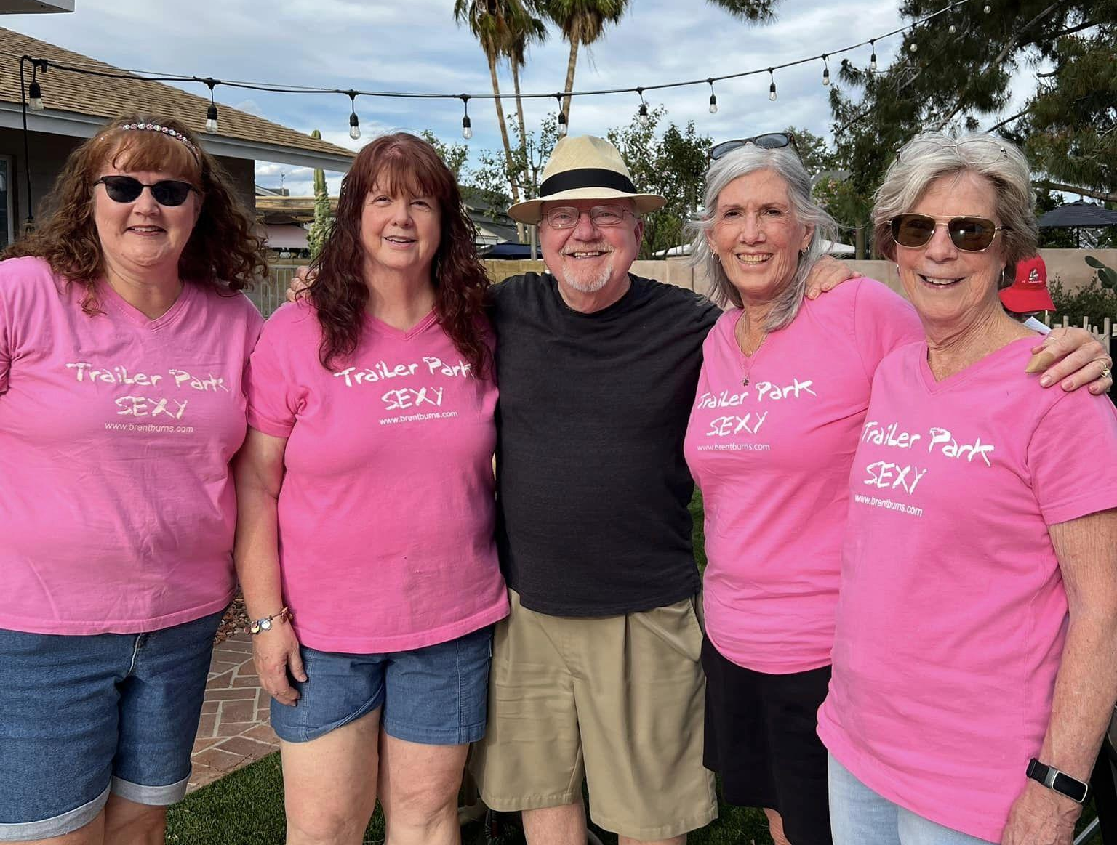
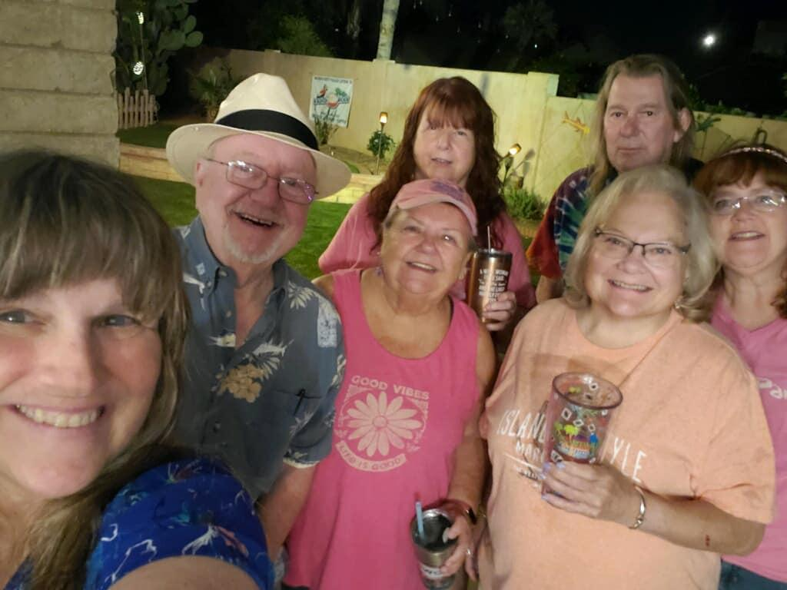
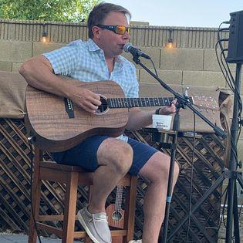
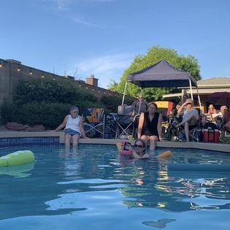
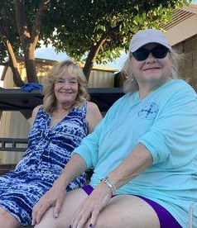
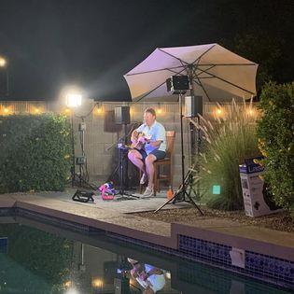
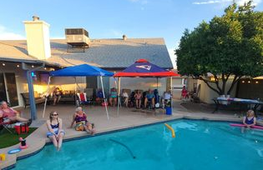
The Arizona Parrot Head Club Newsletter-Q2 2023
Q2 House Concerts…
The Bauman Party Palace hosted Brett Burns on April 22 and a fabulous time was had by all!
The Holt Hacienda hosted Aaron Scherz on June 13 finally making it back after Covid canceled him…such a phun time on a gorgeous evening!!!
CONTACT US: AZPHC PO Box 16093 Phoenix, AZ 85011-6093 Email: phred@parrotheads.org P. 7

Slide 8
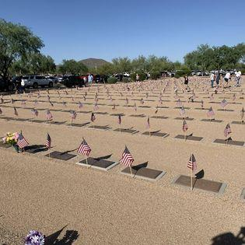
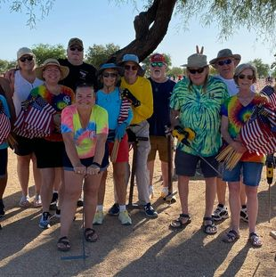
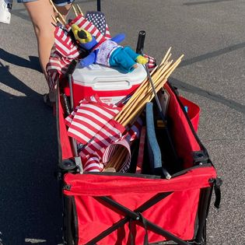
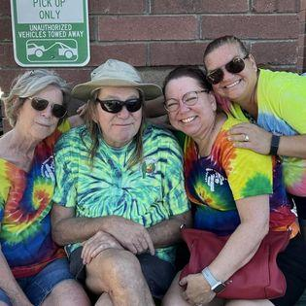
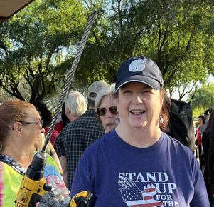
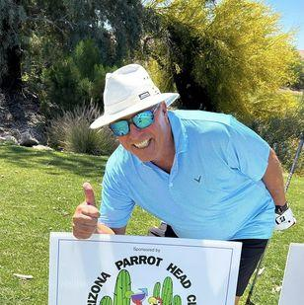
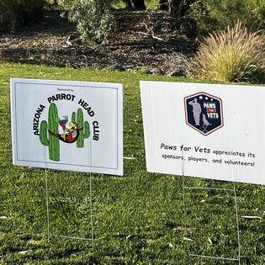
The Arizona Parrot Head Club Newsletter-Q2 2023
Flags on the Graves…by Janet Spittle
On Saturday May 27th at the crack of dawn, 15 parrot heads and phriends met at the National Memorial Cemetery of AZ to place flags on the graves for Memorial Day. We got into a good rhythm and in no time at all placed over 1000 flags before running out of places to put them. The cemetery encompasses 225 acres and memorializes more than 78,000 veterans and spouses. A few of us had prior commitments so only about half of the group was able to go to breakfast at the Sunshine Breakfast Bar after we finished. Once again, the AZ Parrot Heads and phriends were able to “party with a purpose” and have a great time doing it.
Soldiers’ Best Friend Golf Tournament
Our phriend, Frank, turned us on to our Q2 chartiy and a golf tournament where a couple of AZ parrot heads played in AND we even sponsored a hole!!!
CONTACT US: AZPHC PO Box 16093 Phoenix, AZ 85011-6093 Email: phred@parrotheads.org P. 8

Slide 9

The Arizona Parrot Head Club Newsletter-Q2 2023
Parrot Grande Registration is OPEN!!!
CONTACT US: AZPHC PO Box 16093 Phoenix, AZ 85011-6093 Email: phred@parrotheads.org P. 9

Slide 10
The Arizona Parrot Head Club Newsletter-Q2 2021
The Arizona Parrot Head Club Newsletter-Q2 2023
Q3 2023 + Birthdays!!! HAPPY BIRTHDAY, PHRIENDS!!!
July
August
Kathy Osenton Jul-5
PJ Hankins Jul-11
Steve Pfister Jul-14
Charlie LaClair Jul-16
Tom Hankins Jul-21
Tracy Kenison Jul-22
Kurt Evans Jul-26
Paula Masiulewicz Aug-3
Norma Mesa Aug-3
Deborah Sarna Aug-3
Donna Jandro Aug-7
Scott Leeder Aug-9
Tom McGuirk Aug-11
Janet Spittle Aug-14
Steve Chitwood Aug-31
Mark McGuffin Aug-31
September
Chad Lockard Sept-1
Joanne Mangis Sept- 4
Marisa Molinari Sept-5
Kristy Gilluly Sept-11
Andrea Pasquale Sept-24
Vivian McGuffin Sept-26
Vikki Swanson Sept-27
October
William Herring III Oct-4
Mark Sarna Oct-25
Rocky Soderman Oct-27
Kathy Tanton Oct-28
Alan Osenton Oct-29
Are you a Q3 birthday and it’s not listed above??? Sorry about that; but, it means we don’t have it in our files (or your membership renewal!!!
Upcoming Events in 2023…
Jul 8th – Club Happy Hour – Doc &amp; Eddies -Tempe – 4PM
**Aug 18th – Erica Sunshine Lee – Holt Hacienda – TBD
Aug 25-27 – Parrot Grande – Crowne Plaza Chandler
**Sep 8th – Jessie Rice - Holt Hacienda - TBD
**Oct 25-29 – Meeting of the Minds – Gulf Shores, Alabama
** denotes unofficial club event, but just as phun!
CONTACT US: AZPHC PO Box 16093 Phoenix, AZ 85011-6093 Email: phred@parrotheads.org P. 10

Slide 11
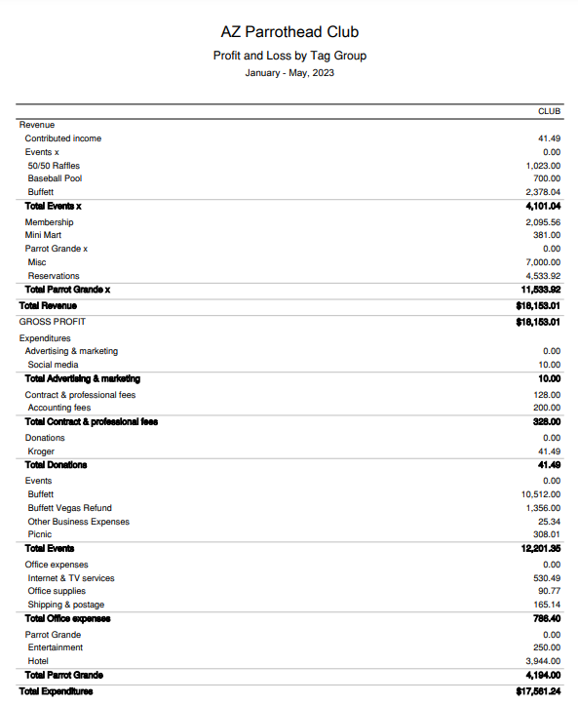




The Arizona Parrot Head Club Newsletter-Q2 2023
Financials
As of June 2, 2023
Club Financials
Foundation Financials
CONTACT US: AZPHC PO Box 16093 Phoenix, AZ 85011-6093 Email: phred@parrotheads.org P. 11

Slide 12








The Arizona Parrot Head Club Newsletter-Q4 2020
The Arizona Parrot Head Club Newsletter-Q3 2021
The Arizona Parrot Head Club Newsletter-Q2 2023
Your 2023 Board of Directors
Prez: Kathy Pfister
wino@parrotheads.org
Veep: Paula Masiulewicz
pmasiulewicz@gmail.com
Treasurer: Lori Matteson
beancntr@parrotheads.org
Secretary: Janet Spittle
janet@parrotheads.org
Member at Large:
Cathy ”Crash” McDonough
cmmcd58@yahoo.com
Member at Large:
Kenny Bishop
kennyb@parrotheads.org
Member at Large:
Mette Rasmussen
mette@parrotheads.org
Member at Large:
Toni Soderman
toni@parrotheads.org
Member at Large:
Denise Karp
denise@parrotheads.org
Make sure to check out the weekly email updates from Phred (the Prez) for anything PHUN going on with our Phlock!
Stay safe all!!!
CONTACT US: AZPHC PO Box 16093 Phoenix, AZ 85011-6093 Email: phred@parrotheads.org P. 9
CONTACT US: AZPHC PO Box 16093 Phoenix, AZ 85011-6093 Email: phred@parrotheads.org P 12

